Slide 1

Presented by: Tullia Vu Foreign Trade University

Slide 2
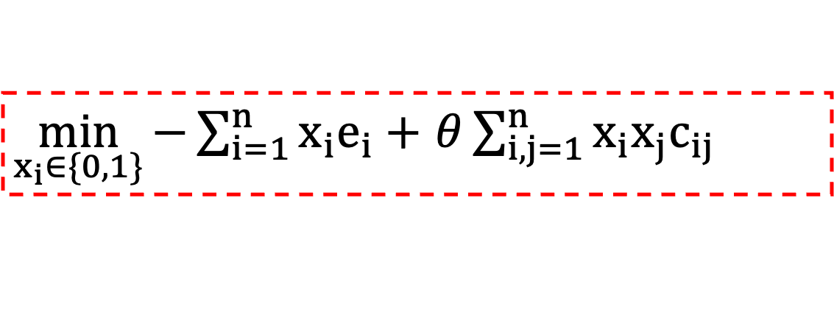
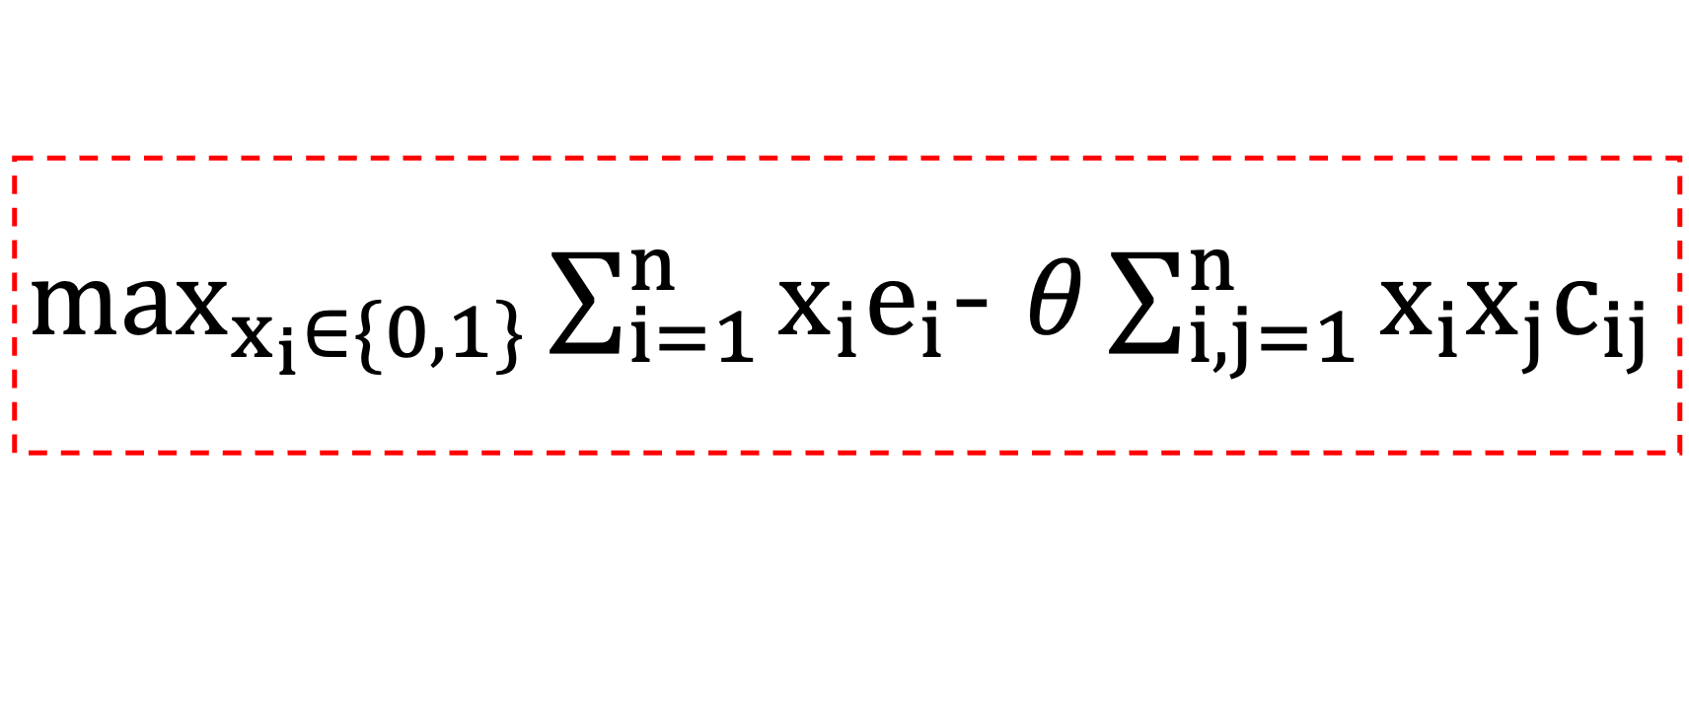
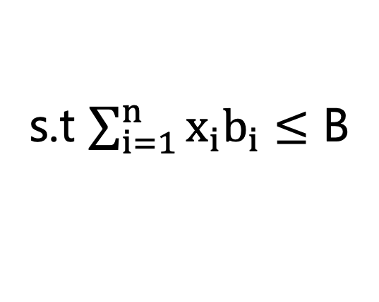
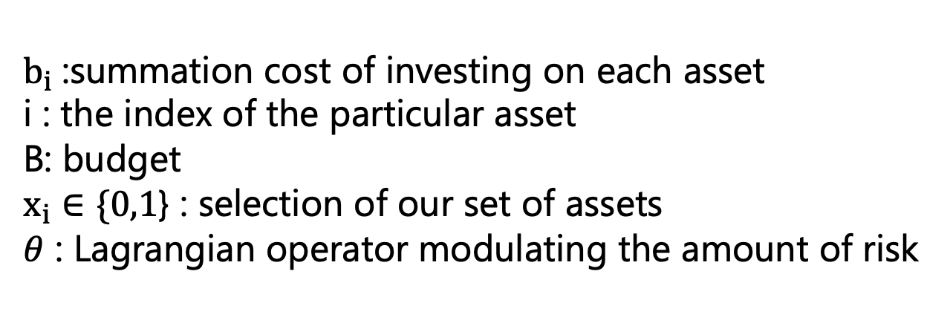
CLASSICAL OPTIMIZATION PROBLEM
$\max_{x_{i}∈\{0,1\}}{\sum_{i=1}^{n}{x_{i}e_{i}}}$- $θ\sum_{i,j=1}^{n}{x_{i}x_{j}c_{ij}}$
s.t $\sum_{i=1}^{n}{x_{i}b_{i}}≤$ B
$\min_{x_{i}∈\{0,1\}}{−\sum_{i=1}^{n}{x_{i}e_{i}}}+$ $θ\sum_{i,j=1}^{n}{x_{i}x_{j}c_{ij}}$
$b_{i}$:summation cost of investing on each asset
i : the index of the particular asset
B: budget
$x_{i}∈\{0,1$} : selection of our set of assets
$θ$ : Lagrangian operator modulating the amount of risk
return
risk
Notes:
In the theory of portfolio optimization, the overall risk of a portfolio is related to the covariance between assets, which is proportional to the correlation coefficients of any two assets. The smaller the correlation coefficients, the smaller the covariance, and then the smaller the overall risk of the portfolio

Slide 3
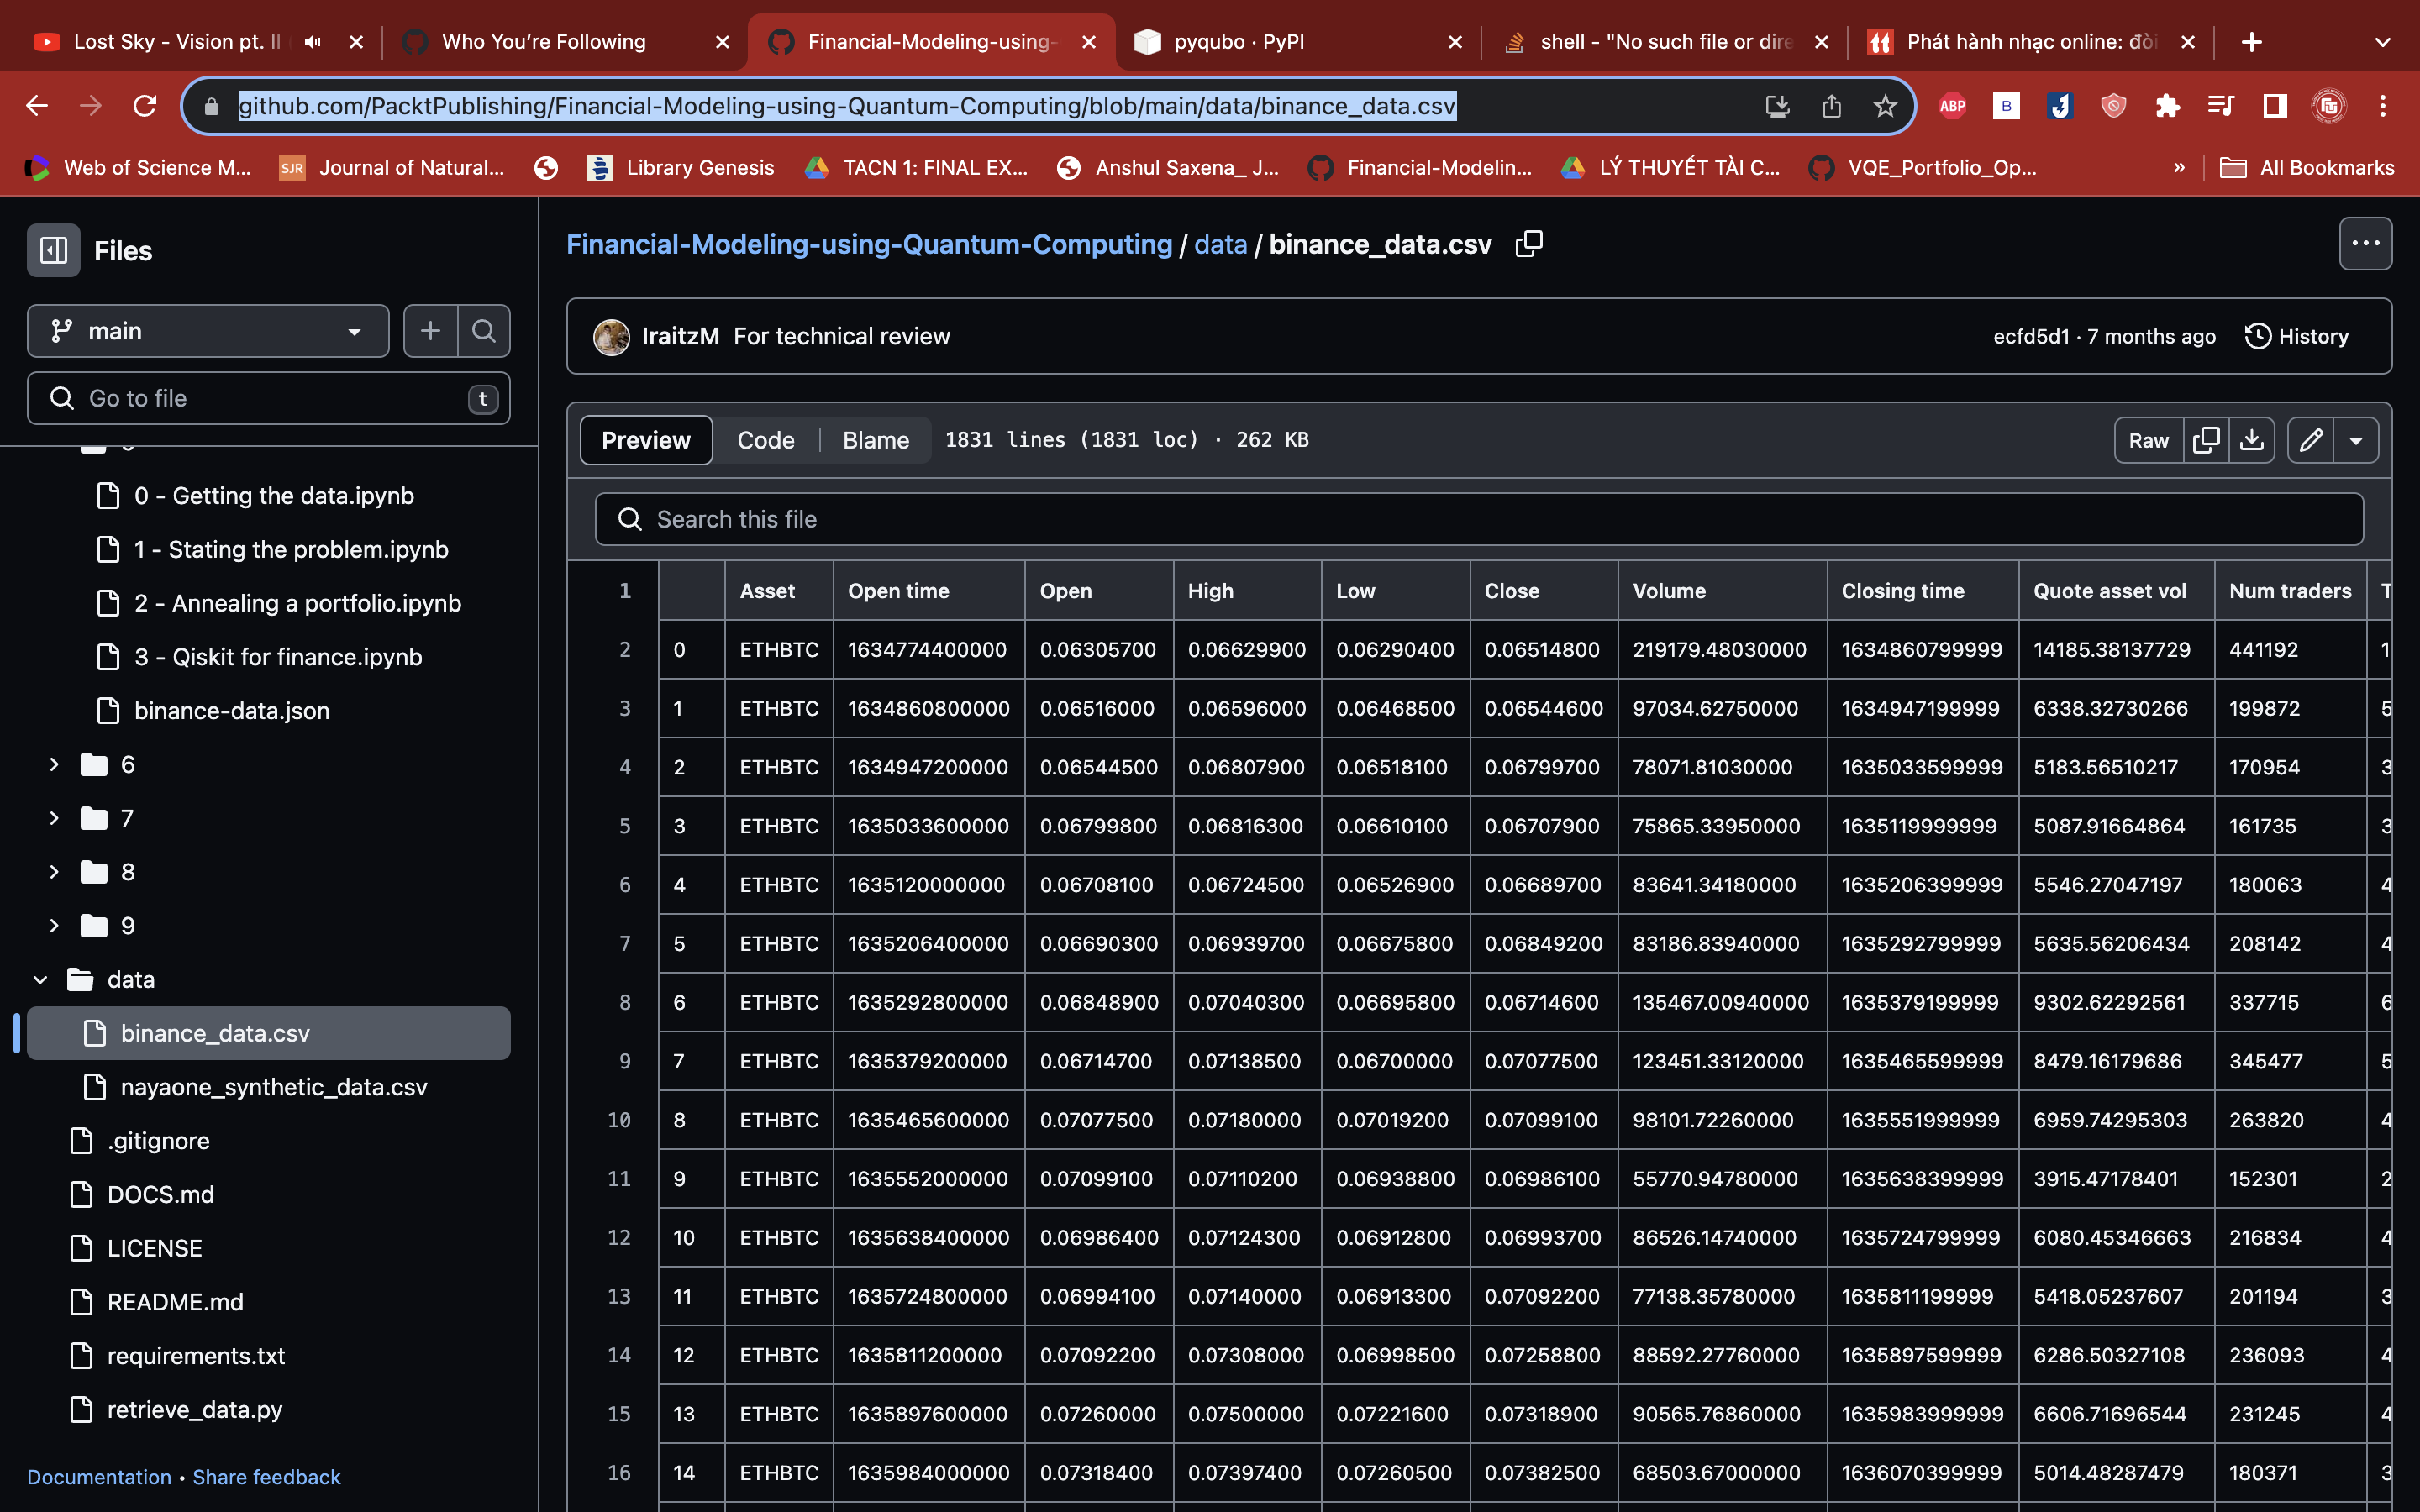

Data
Open price
Close price
Return = $\frac{close price −open price}{open price}$

Slide 4
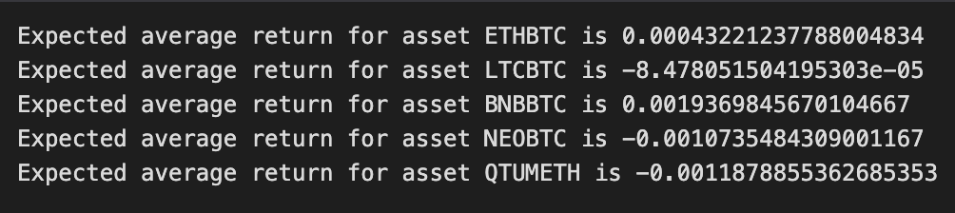
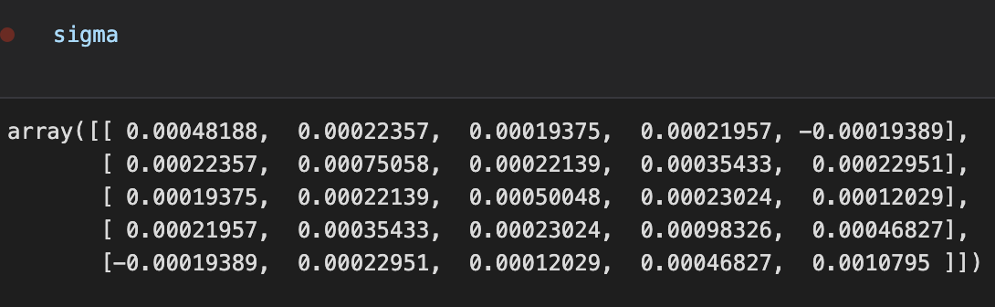
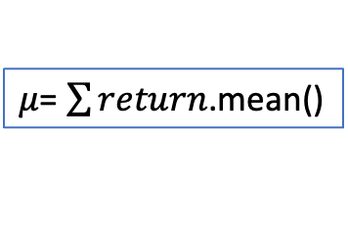

Data Preparation’s Result
$μ$= $\sum{return}$.mean()
$$σ=cov(return)$$

Slide 5
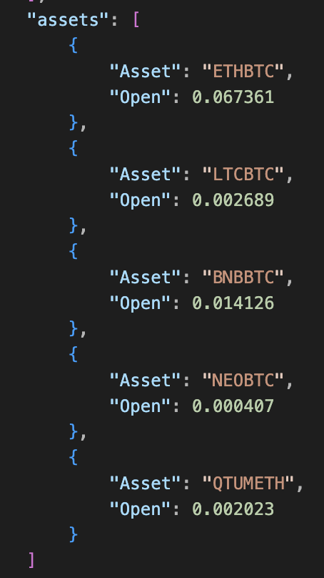
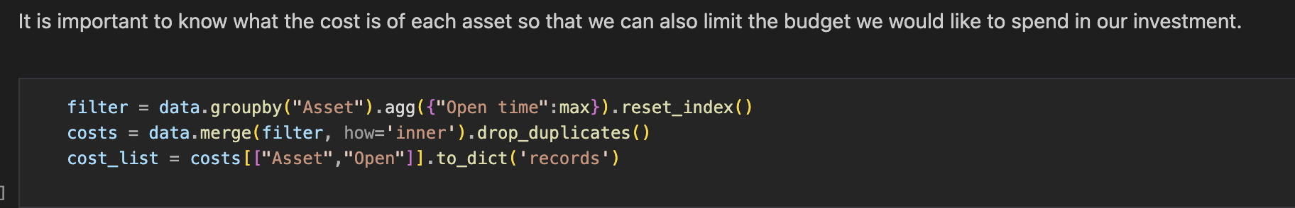
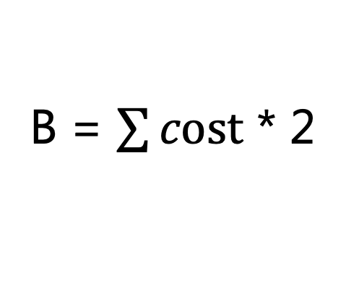
Không hiểu cái cost lắm
Cost là open đắt nhất của mỗi asset
B = $\sum{cost}$ * 2

Slide 6
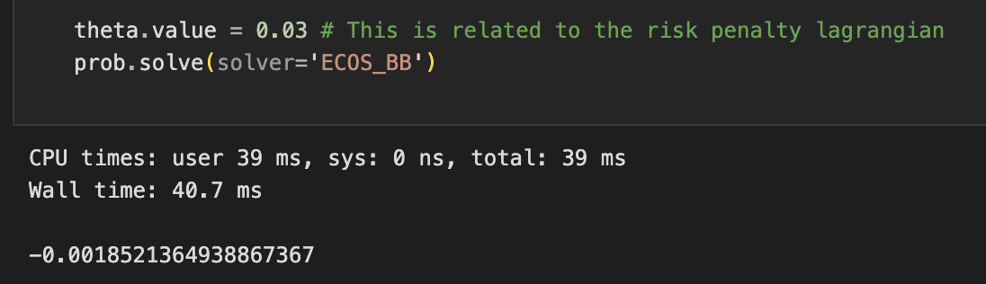
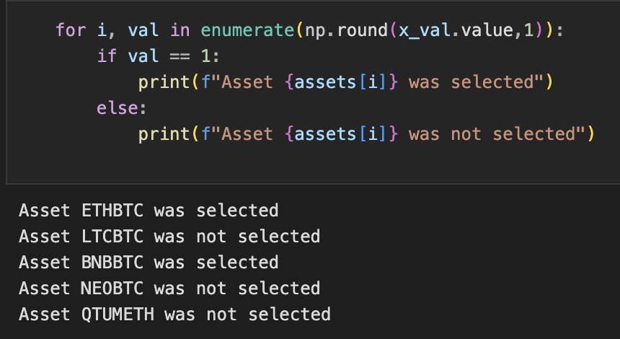
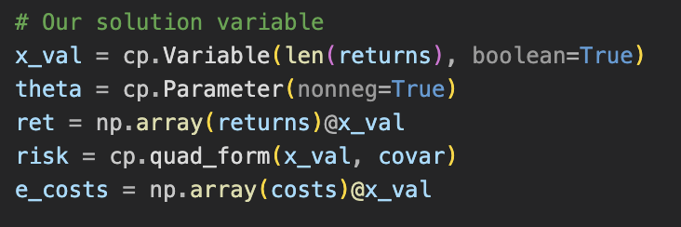

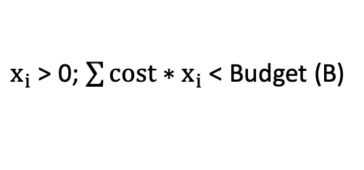
CLASSICAL: CVXPY
Solver ECOS_BB
Constraint
$x_{i}$ > 0; $\sum{cost∗x_{i}}$ < Budget (B)
Objective function
obj = $min (−ret$ + theta*risk)
theta = risk aversion parameter 0.03 (arbitrarily)

Slide 7
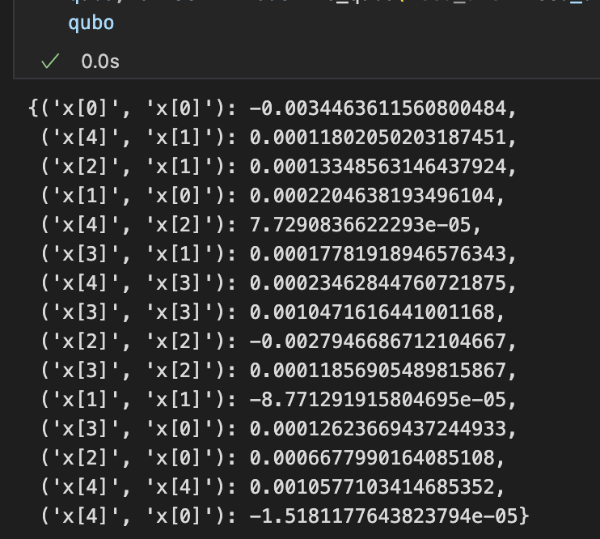
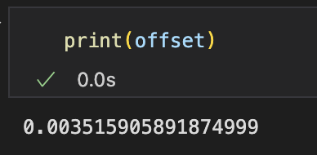
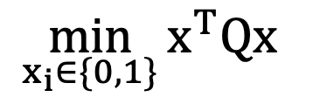
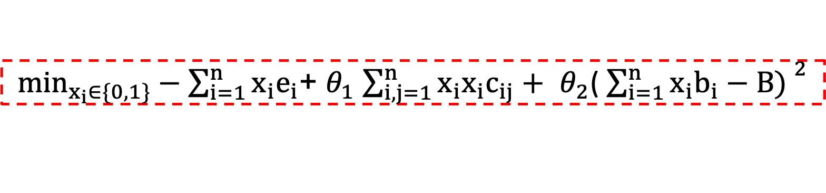
ANNEALER: QUBO
$$\min_{x_{i}∈\{0,1\}}{x^{T}Qx}$$
x is a vector of binary decision variables
Q is a square matrix of constants
Using D-Wave
quantum annealer (Ising model)
$\min_{x_{i}∈\{0,1\}}−\sum_{i=1}^{n}{x_{i}e_{i}}$+ $θ_{1}$ $\sum_{i,j=1}^{n}{x_{i}x_{i}c_{ij}+ }$ $θ_{2}$( ${\sum_{i=1}^{n}{x_{i}b_{i}−B) }}^{2}$
Expected return
variance
cost - budget
linear
quadratic
linear

Slide 8
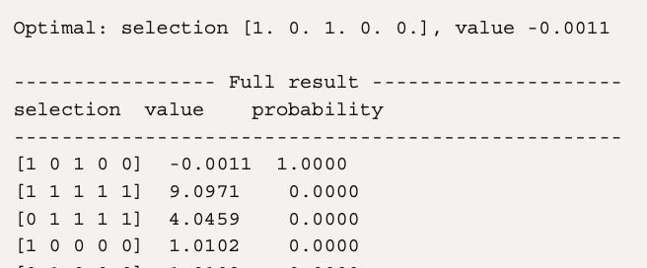

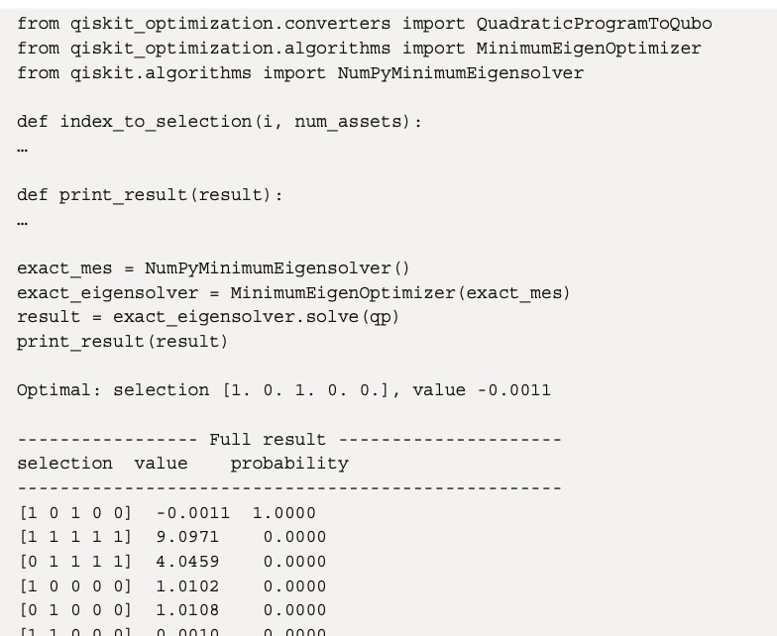
QISKIT FINANCE
classical NumPy-based solver

Slide 9
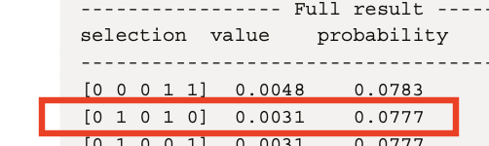
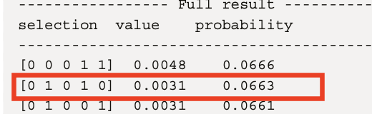
Parameterized Quantum Circuit (PQC) / ansatz
Algorithm : Quantum Approximate Optimization Algorithm (QAOA)
Optimizer: COBYLA
Layer =2
Layer =5
we can try varying the optimization method of the approach in general, looking for a different ansatz composition !

Slide 10
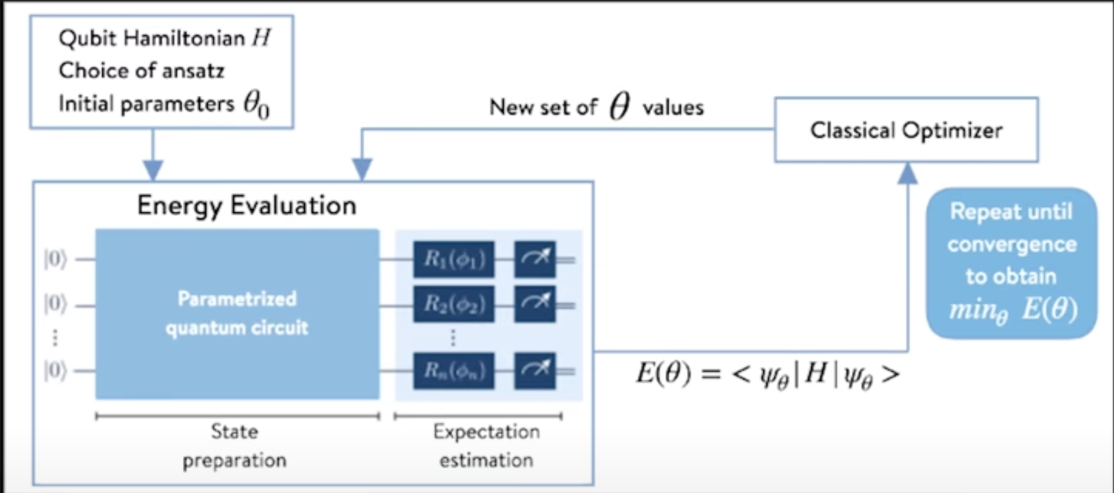
Variational Quantum Eignesolver (VQE)

